Slide 1

Sapthagiri NPS University Department of Computer Science and Engineering
Movie Ticket Management System
Presented by:
Tejaswini S: 24SUUBECS2265
Teju K G: 24SUUBECS2266
Thanish K L: 24SUUBECS2267
Under the Guidance of
Faculty Name: Mrs. Swetha D
Designation: Assistant Professor
Department: CSE Department

Slide 2
Agenda
Introduction
Problem Definition
Database Design
Tables and Relationships
SQL Queries / CRUD Operations
Frontend and Output
Advantages and Limitations
Conclusion
Future Scope
References

Slide 3
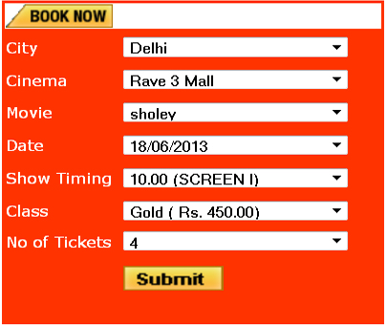
Introduction
The Movie Ticket Booking System is a database-based application used for online movie ticket reservations.
It helps users book movie tickets quickly and easily.
Customers can view movie schedules, select seats, and make bookings online.
The system reduces manual work in theatres.
It stores customer, movie, theatre, and booking details efficiently.

Slide 4
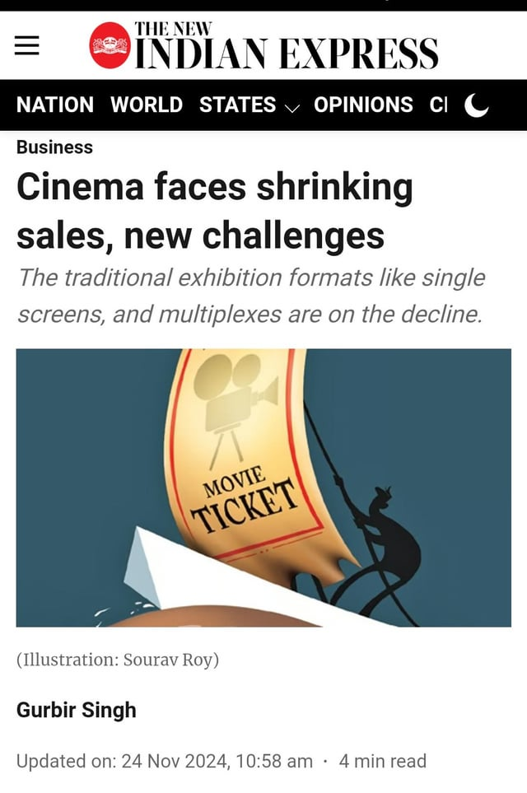
Problem Definition
Real-World Problem
Manual ticket booking process consumes more time.
Customers need to stand in long queues for tickets.
Difficulties Faced Without the System
Duplicate seat booking may happen.
Increased paperwork and manual calculations.
Need for the Project
To automate the movie ticket booking process.
To provide online ticket reservation facilities.

Slide 5
Database Design
The ER diagram includes entities such as Customer, Movie, Theatre, Screen, Seat, Booking, and Payment.
Entities have attributes such as Customer_ID, Customer_Name, Phone_Number, Movie_ID, Movie_Name, Theatre_Name, Screen_ID, Seat_Number, Booking_ID, Booking_Date, Payment_ID, Amount, and Payment_Status.
Primary keys are used to uniquely identify each record in a table and prevent duplicate entries in the database. For example, Customer_ID uniquely identifies each customer. Foreign keys are used to create relationships between different tables in the database. For example, Customer_ID in the Booking table is used as a foreign key to connect the Booking table with the Customer table.
The Movie Ticket Booking System database is normalized up to Third Normal Form (3NF) to reduce data redundancy and improve data consistency. Normalization helps organize data efficiently and avoids duplicate records in the database..

Slide 6
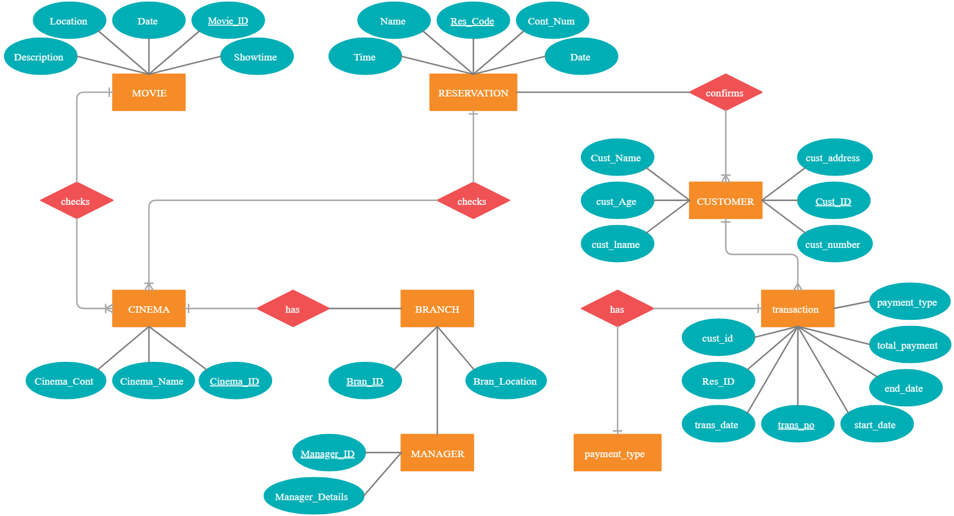
ER Diagram — Movie Ticket Booking System

Slide 7
Tables and Relationships
Important Tables Used in the Project
Tables and Relationships
• Customer (Customer_ID PK, Customer_Name, Phone_Number, Email)
• Movie (Movie_ID PK, Movie_Name, Genre, Duration, Language)
• Theatre (Theatre_ID PK, Theatre_Name, Location)
• Screen (Screen_ID PK, Screen_Name, Theatre_ID FK) — One-to-Many with Theatre
• Seat (Seat_ID PK, Seat_Number, Screen_ID FK) — One-to-Many with Screen
• Booking (Booking_ID PK, Customer_ID FK, Movie_ID FK, Seat_ID FK, Booking_Date) — manages ticket reservations
• Payment (Payment_ID PK, Booking_ID FK, Amount, Payment_Method, Payment_Status) — One-to-One with Booking

Slide 8
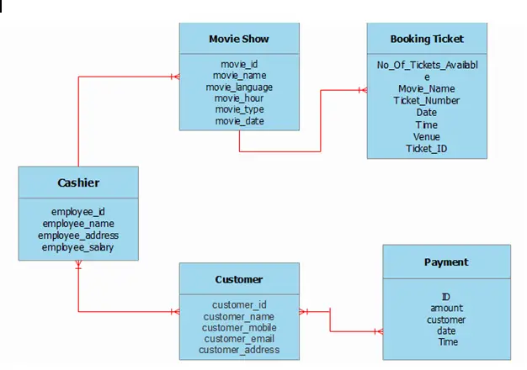
Database Tables — Schema

Slide 9
SQL Queries / CRUD Operations
SQL Queries / CRUD Operations
• INSERT: INSERT INTO Customer VALUES (101, 'Rahul', '9876543210', 'rahul@gmail.com');
• SELECT: SELECT c.Customer_Name, m.Movie_Name FROM Booking b JOIN Customer c ON b.Customer_ID = c.Customer_ID JOIN Movie m ON b.Movie_ID = m.Movie_ID;
• UPDATE: UPDATE Payment SET Payment_Status='Paid' WHERE Payment_ID=201;
• DELETE: DELETE FROM Booking WHERE Booking_ID=105;
• Aggregate: SELECT Movie_Name, COUNT(*) AS Total_Bookings FROM Movie GROUP BY Movie_Name;

Slide 10
Frontend / Interface — Application Screens
User View screen displays all available movies with title, show time, price, and available seats.
Movie Booking screen allows users to enter name and select number of seats for booking.
Ticket Receipt section shows movie name, customer name, seats booked, total price, and booking time.
Notification system displays success messages after ticket booking or adding movies.
Admin Panel is used to add new movies with title, time, price, and total seats.
Movie Database Management stores movie details using browser local storage.
Seat Availability System updates available seats automatically after each booking.
Sold Out feature disables booking when all seats are booked.
HTML is used for webpage structure and forms.
CSS is used for styling, layout, colors, and popup design.

Slide 11
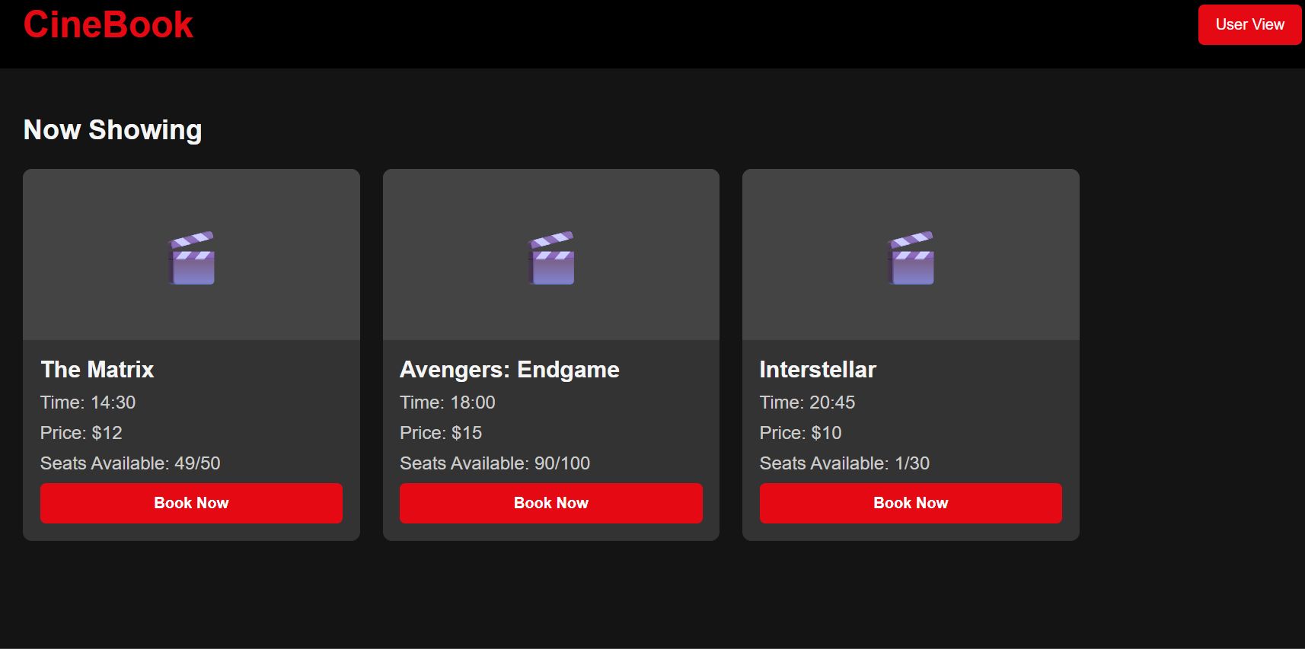
USER VIEW

Slide 12
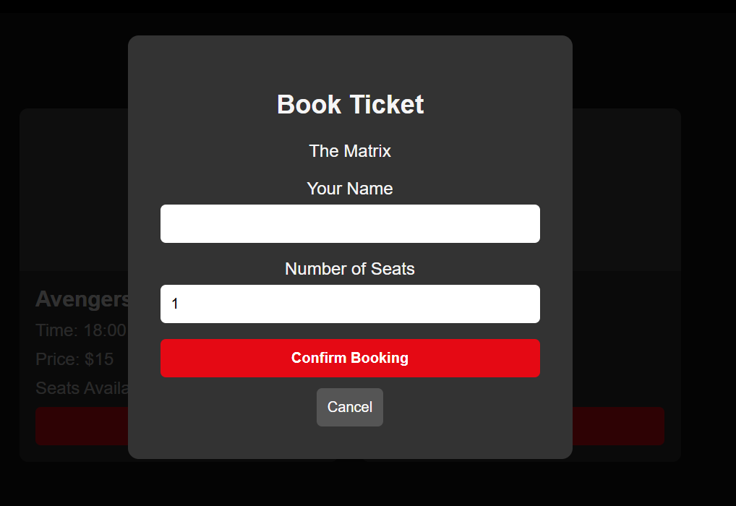
MOVIE BOOKING SCREEN

Slide 13
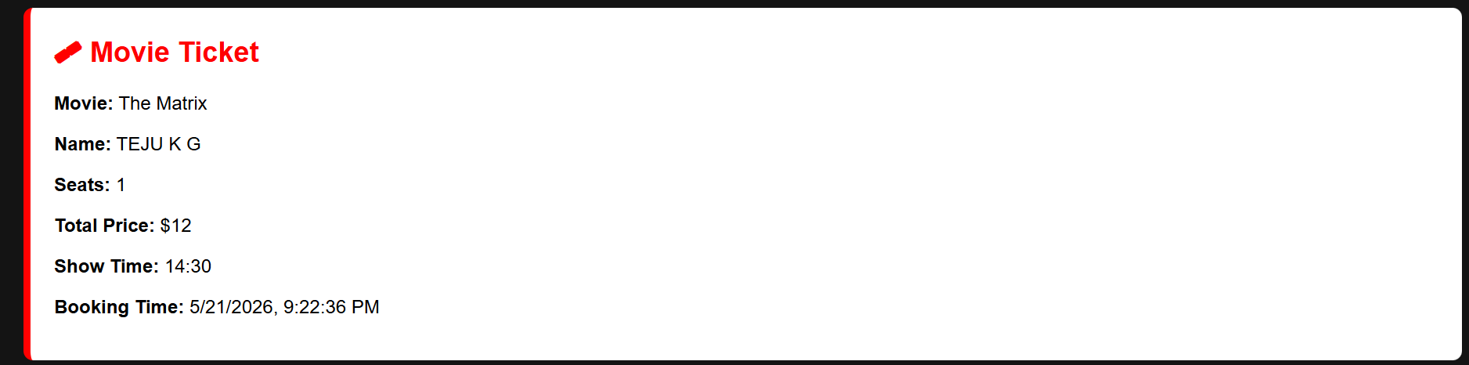
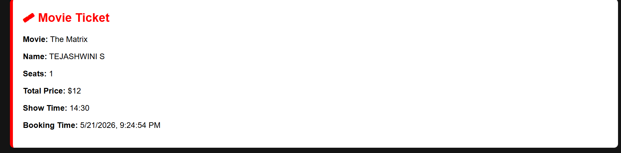
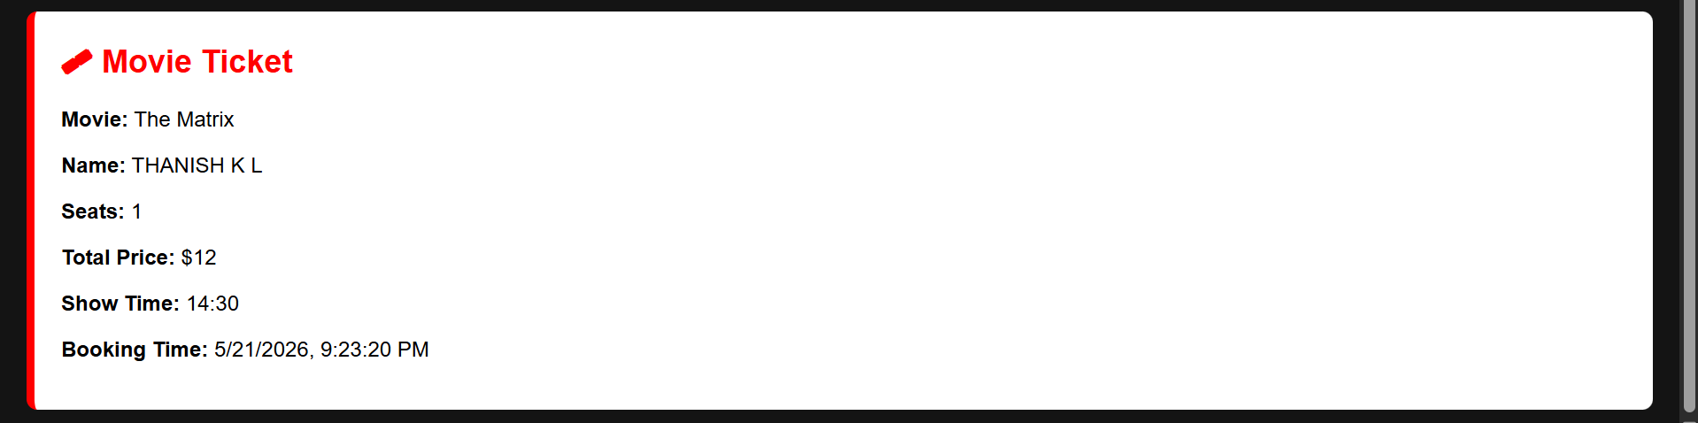
TICKET RECEIPT

Slide 14
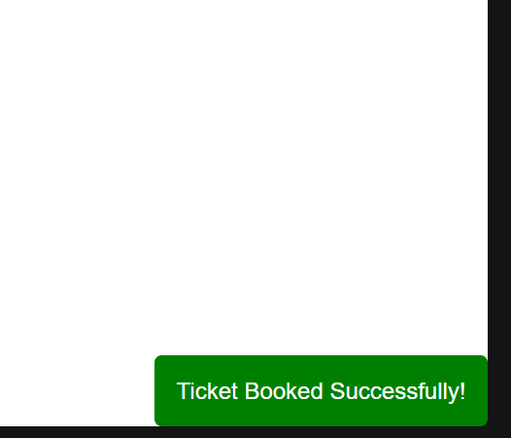
NOTIFICATION SYSTEM

Slide 15
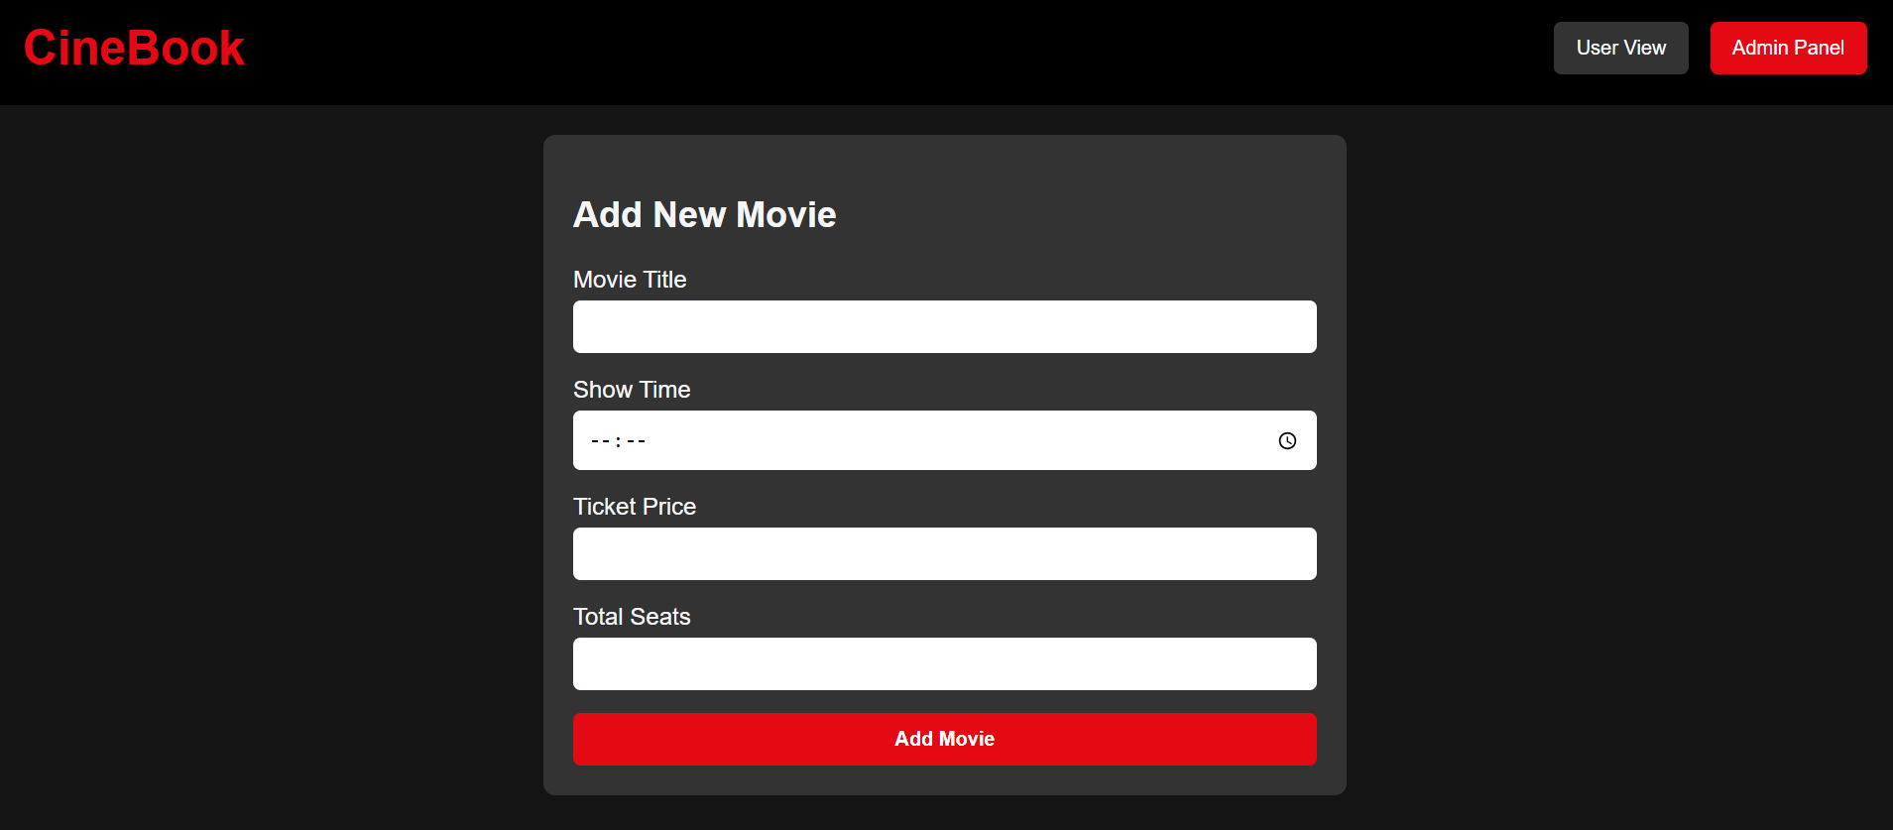
ADMIN PANEL

Slide 16
Functionality and Output
The following functionalities and outputs are part of the Movie Ticket Booking System web application:
Movie Search Output: Displays available movies, show timings, screen number, language, and seat availability.
Ticket Booking Confirmation: On successful booking, the system generates a confirmation receipt with movie name, seat numbers, date, and timing details.
Seat Selection System: Allows users to select preferred seats with real-time availability updates.
Payment Processing: Supports secure online payment through debit card, credit card, UPI, and net banking.
Booking Cancellation: Users can cancel booked tickets within the allowed time and receive refund details.
E-Ticket Generation: Generates digital tickets with booking ID, QR code, and theater details for entry verification.
Notifications and Alerts: Sends booking confirmation, payment success, and movie reminder notifications via email or SMS.
Admin Movie Management: Enables admin to add, update, or remove movies, show timings, and theater details.
Reports: Generates daily and monthly reports showing total bookings, revenue, popular movies, and customer activity.
User Account Management: Allows users to register, login, manage profiles, and view booking history.

Slide 17
Innovation / Additional Features
Innovation / Additional Features
Easy Seat Selection: Users can choose seats based on availability with real-time seat status updates.
Online Payment Integration: Supports secure payment methods such as UPI, credit/debit cards, net banking, and wallets.
Movie Search & Filters: Search movies by title, genre, language, theatre, show timing, or ratings.
Booking Confirmation Notification: System sends booking confirmation and e-tickets through email or SMS instantly.
Dashboard: Real-time statistics showing total bookings, active users, running movies, and revenue collection.
PDF Ticket Export: Generate and download movie tickets and booking receipts in PDF format.
Login Security: Role-based access control — Admin, Theatre Manager, and Customer have separate permissions.
Cancellation & Refund: Users can cancel tickets online and receive refund updates automatically.

Slide 18
Advantages and Limitations
Advantages and Limitations
Advantages:
Saves time by automating movie ticket booking, payment, and cancellation processes.
Reduces errors in seat allocation and booking records; improves accuracy of customer and transaction data.
Easy-to-use interface allows customers and theatre staff to operate without technical expertise.
Provides real-time seat availability and instant booking confirmation notifications.
Supports secure online payments with multiple payment options for user convenience.
Limitations:
Requires internet/network connectivity for online booking; offline booking support is limited.
High traffic during new movie releases may slow down the system performance.
Online payment failures or server issues can occasionally affect ticket booking.
Depends on regular system maintenance and updates for smooth operation and security.

Slide 19
Conclusion
The Movie Ticket Booking System successfully automates core theatre operations including movie scheduling, ticket booking, seat management, and payment processing.
It solves the problem of manual ticket booking by providing a centralized, accurate, and efficient online booking platform.
The system benefits theatre management by reducing workload and improving booking management, while customers benefit from quick seat selection and instant ticket confirmation.
This project demonstrates practical application of DBMS concepts including SQL queries, normalization, ER diagrams, and CRUD operations.
The system also enhances user experience through secure online payments, real-time seat availability, and automated booking notifications.

Slide 20
Future Scope
Mobile Application: Develop Android/iOS app for members to search books and check availability remotely.
Cloud Database: Migrate to cloud platforms (AWS RDS / Google Cloud SQL) for scalability and remote access.
AI Integration: Implement book recommendation engine based on member borrowing history and preferences.
Analytics Dashboard: Visual charts showing borrowing trends, most popular genres, and peak usage times.
QR Code / Barcode Scanning: Enable quick book check-in and check-out using barcode scanners.

Slide 21
References
References
Abraham Silberschatz, Henry F. Korth, S. Sudarshan — “Database System Concepts”, 7th Edition, McGraw-Hill Education, 2019.
W3Schools SQL Tutorial: W3Schools SQL Tutorial
MySQL Official Documentation: MySQL Documentation
GeeksforGeeks — Movie Ticket Booking System Database Design: GeeksforGeeks DBMS Articles
TutorialsPoint — DBMS Tutorial: TutorialsPoint DBMS Tutorial
Oracle Database Documentation: Oracle Database Docs

Slide 22
Thank You

